Slide 1
ANIMAL SPECIES PREDICTION
RITHIKA S

Slide 2
PROJECT TITLE
Animal Species Prediction using Convolutional Neural Networks

Slide 3
ADENDA
The agenda of this project is to develop a deep learning model capable of accurately predicting the species of animals based on images using convolutional neural networks (CNNs). By leveraging state-of-the-art techniques in deep learning, we aim to contribute to the field of computer vision and advance our understanding of automated species identification.

Slide 4
PROBLEM STATEMENT
Traditional methods of animal species identification often rely on manual observation by experts, which can be time-consuming, subjective, and impractical for large-scale applications. An automated system capable of accurately identifying animal species from images would greatly benefit fields such as wildlife conservation, veterinary science, and ecological research.

Slide 5
PROJECT OVERVIEW
This project involves collecting a diverse dataset of animal images, preprocessing the data, training a CNN model for species classification, and evaluating its performance. The trained model will then be deployed as a tool for automated species identification.

Slide 6
END USER
Wildlife conservation organizations
Veterinarians and animal care professionals
Ecological researchers and field biologists

Slide 7
SOLUTION AND VALUE PROPOSITION
Our solution involves developing a CNN-based model trained on a large dataset of annotated animal images. The model will be able to accurately classify images into different animal species, providing a fast and reliable method for species identification. The value proposition lies in the efficiency, accuracy, and scalability of the automated identification system, which can significantly streamline workflows and improve decision-making in various domains.

Slide 8
THE “WOW” FACTOR
The “wow” factor of our solution lies in its ability to accurately identify animal species from images with minimal human intervention. By harnessing the power of deep learning, our system can handle diverse species and complex visual patterns, surpassing the capabilities of traditional methods and opening up new possibilities for research and conservation efforts.

Slide 9
MODELLING
We will use a pre-trained CNN architecture as the base model and fine-tune it on our dataset using transfer learning. The model will be trained to classify images into multiple classes corresponding to different animal species. We will employ techniques such as data augmentation, regularization, and hyperparameter tuning to optimize model performance.

Slide 10
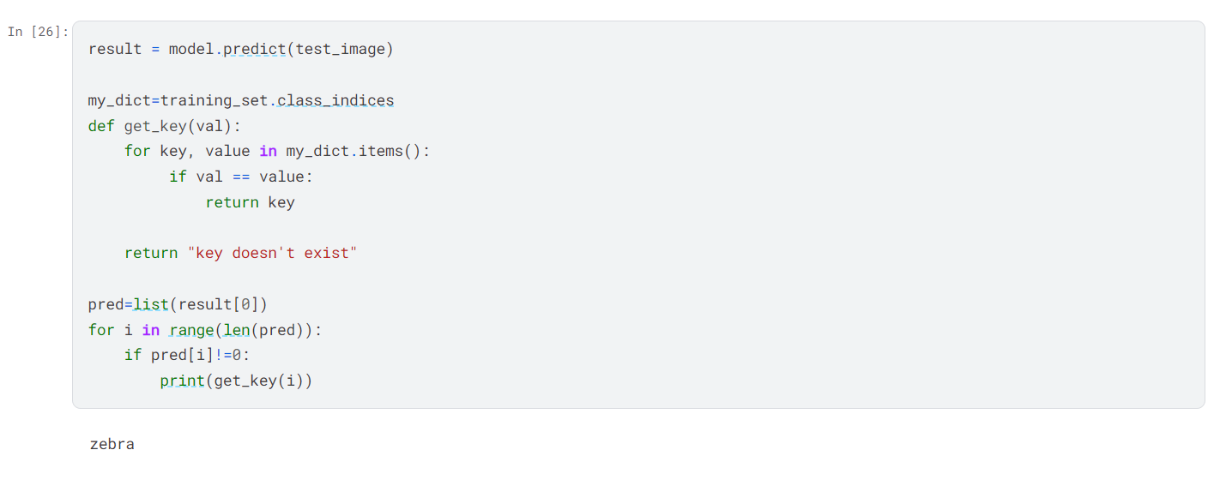
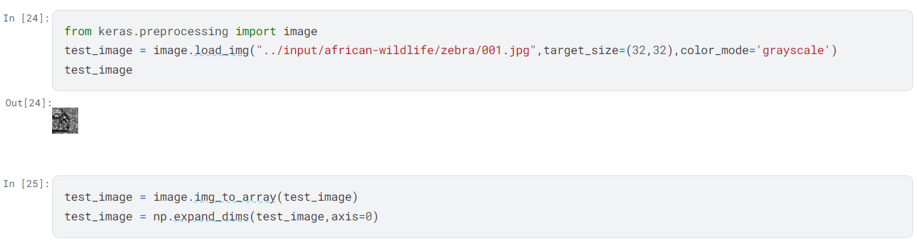
RESULT
Upon completion of the project, we expect to have a trained CNN model capable of accurately predicting animal species from images with high precision and recall. We will evaluate the model's performance using metrics such as accuracy, precision, recall, and F1-score, and demonstrate its effectiveness through real-world case studies and application scenarios.

